Slide 1
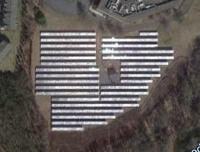
Capstone Project
Solar Energy Forecasting and Performance Modeling
Ruth Caswell Smith
February 26, 2021

Slide 2
Context
Can we develop an accurate time series forecast for energy output and poor performance for a solar array?
Can we develop a classifier to predict poor performance ?

Slide 3
Key Findings
Facebook Prophet was used to forecast both energy output for the entire array as well as poor performance for each inverter.
Random forest and support vector classifiers were optimized to predict poor performance.

Slide 4
Dataset Overview
15-minute data over six years
Data is very noisy
Lots of missing data
No outage data available

Slide 5
Features
Power data for entire array
Power, current, and voltage for each inverter
Module and ambient temperature measurements
Irradiance measurements

Slide 6
Missing Values
For forecasting energy output, data was filled in intelligently so that long outages did not impact overall trend
For predicting performance issues, missing data was assumed to indicate an outage

Slide 7
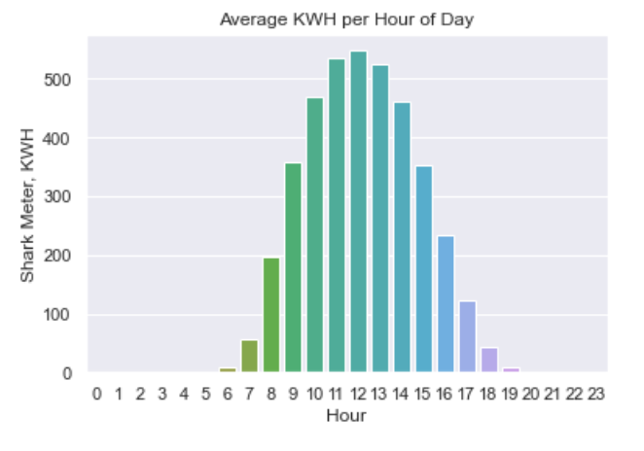
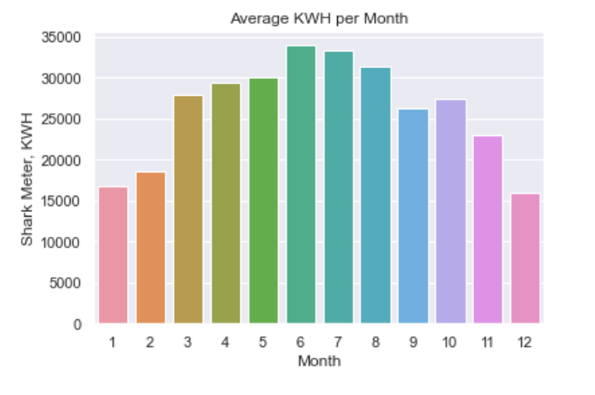
Seasonality

Slide 8
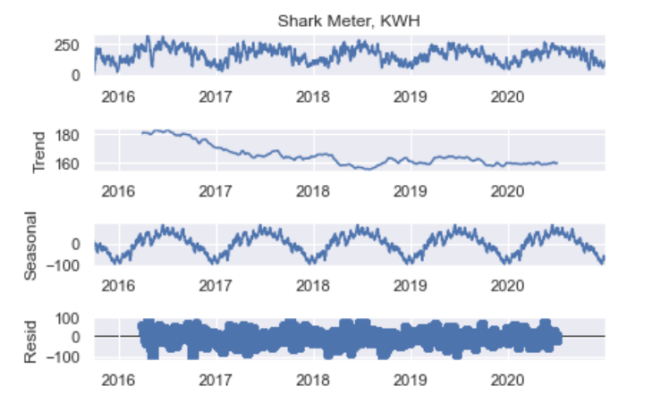
Seasonal Decomposition

Slide 9
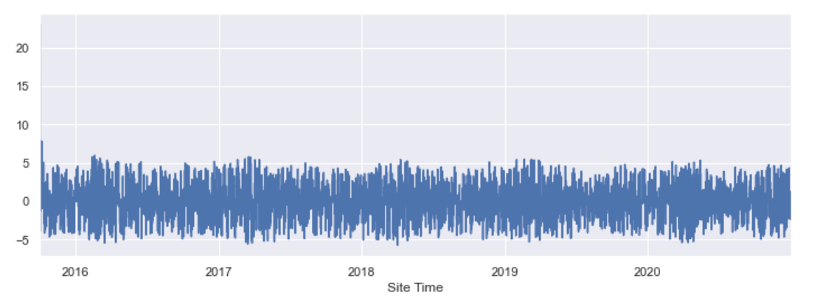
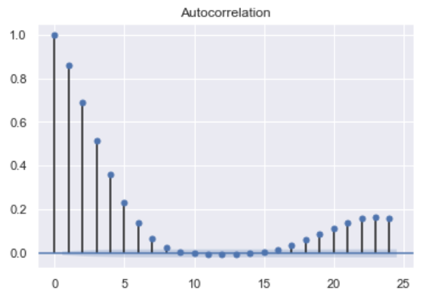
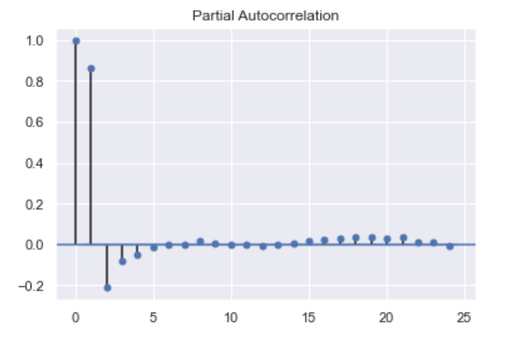
Differenced Time Series

Slide 10
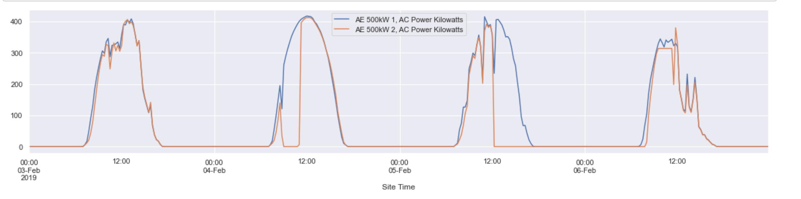
Poor Performance
Calculated as the difference each inverter under-performed the other inverter.

Slide 11
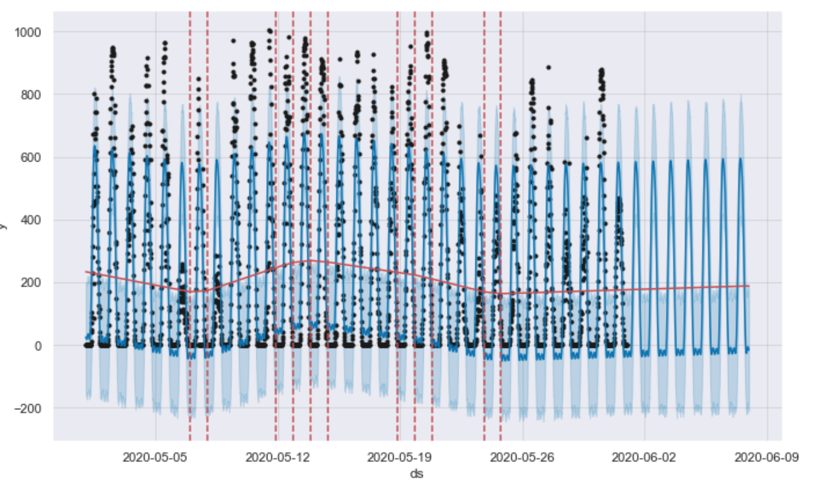
Time Series Forecasting of Energy Output

Slide 12
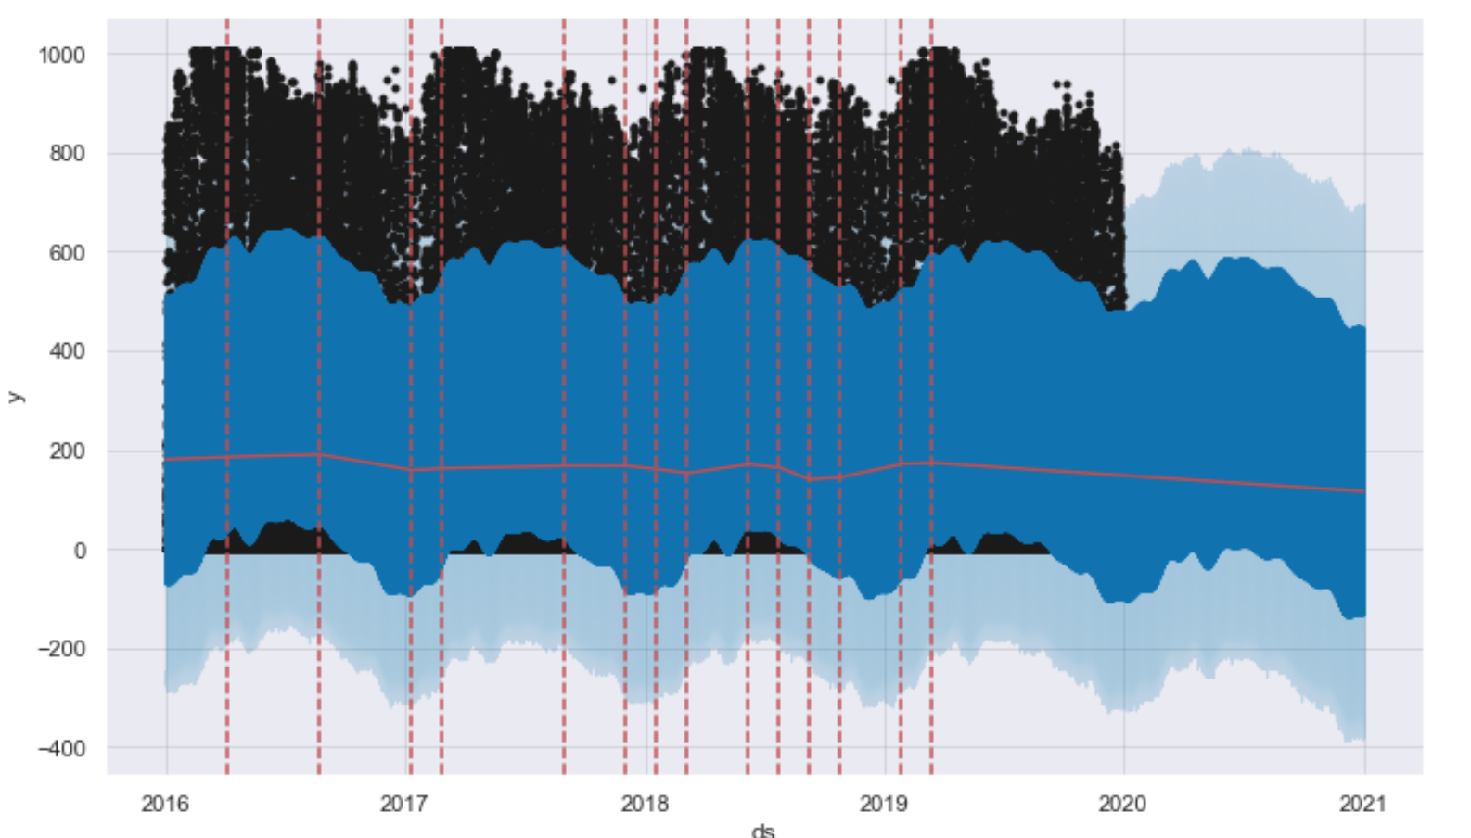
Energy Forecast for 2020

Slide 13
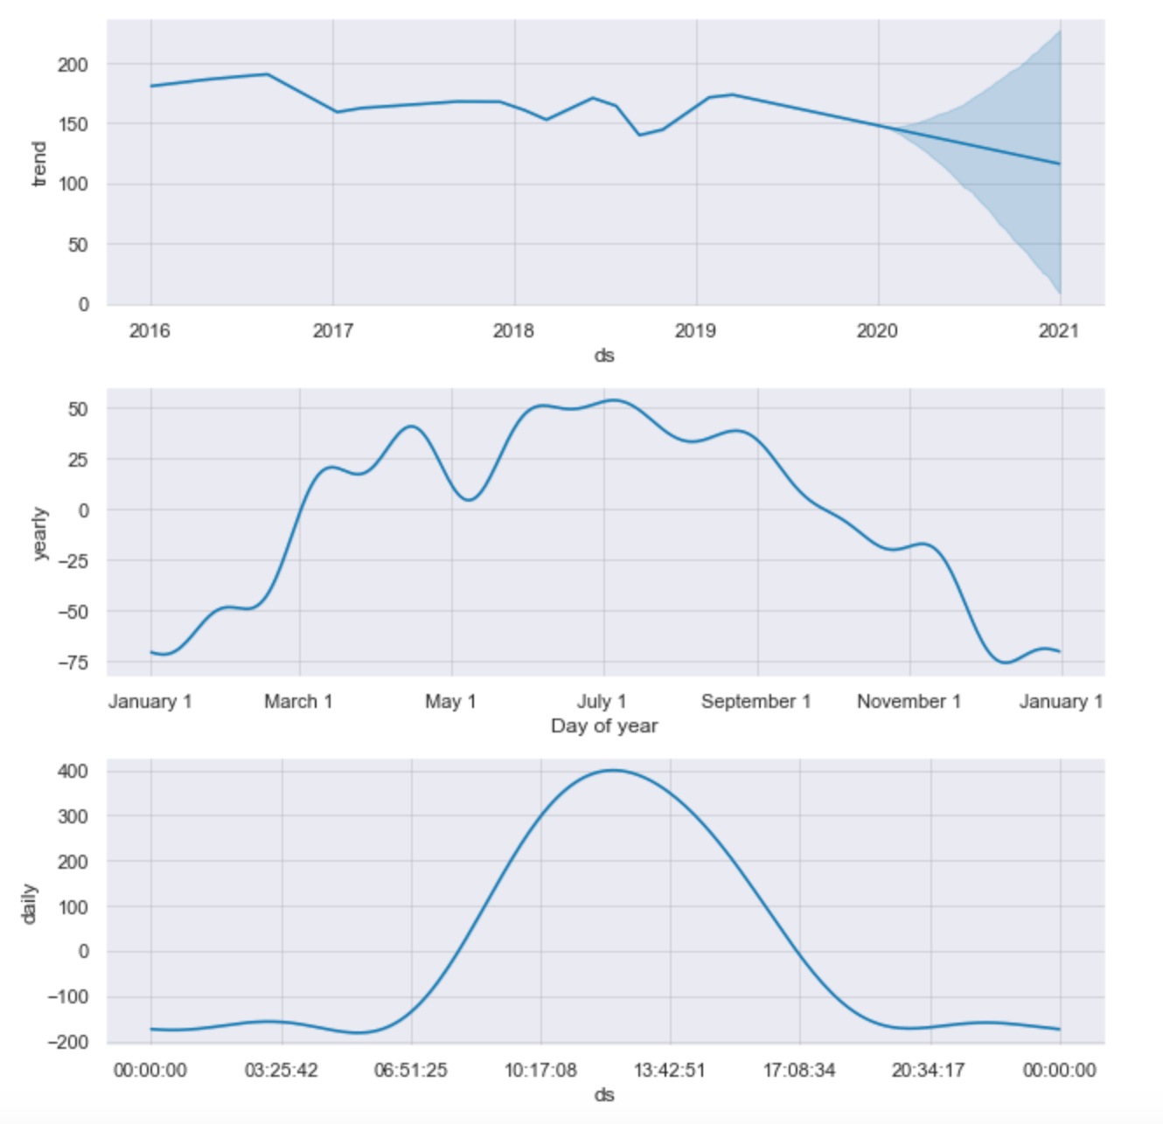
Energy Forecast for 2020

Slide 14
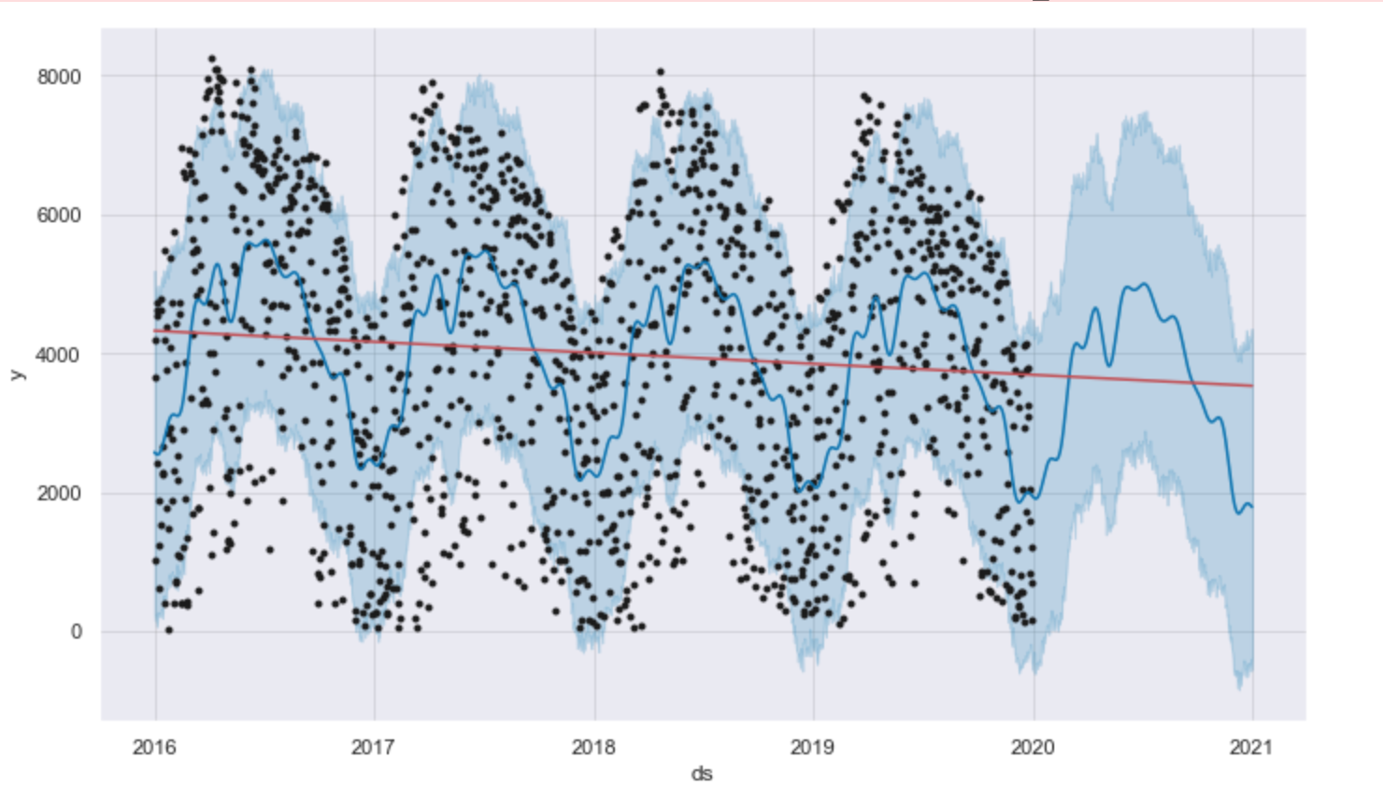
Optimized with Cross-Validation and Hyper-Parameter Tuning

Slide 15
Time Series Forecasting of Poor Performance
Daily data forecast
Exogenous variables added, including temperature and max difference between inverters
Cross-validation
Hyper-parameter tuning
Metric of RMSE

Slide 16
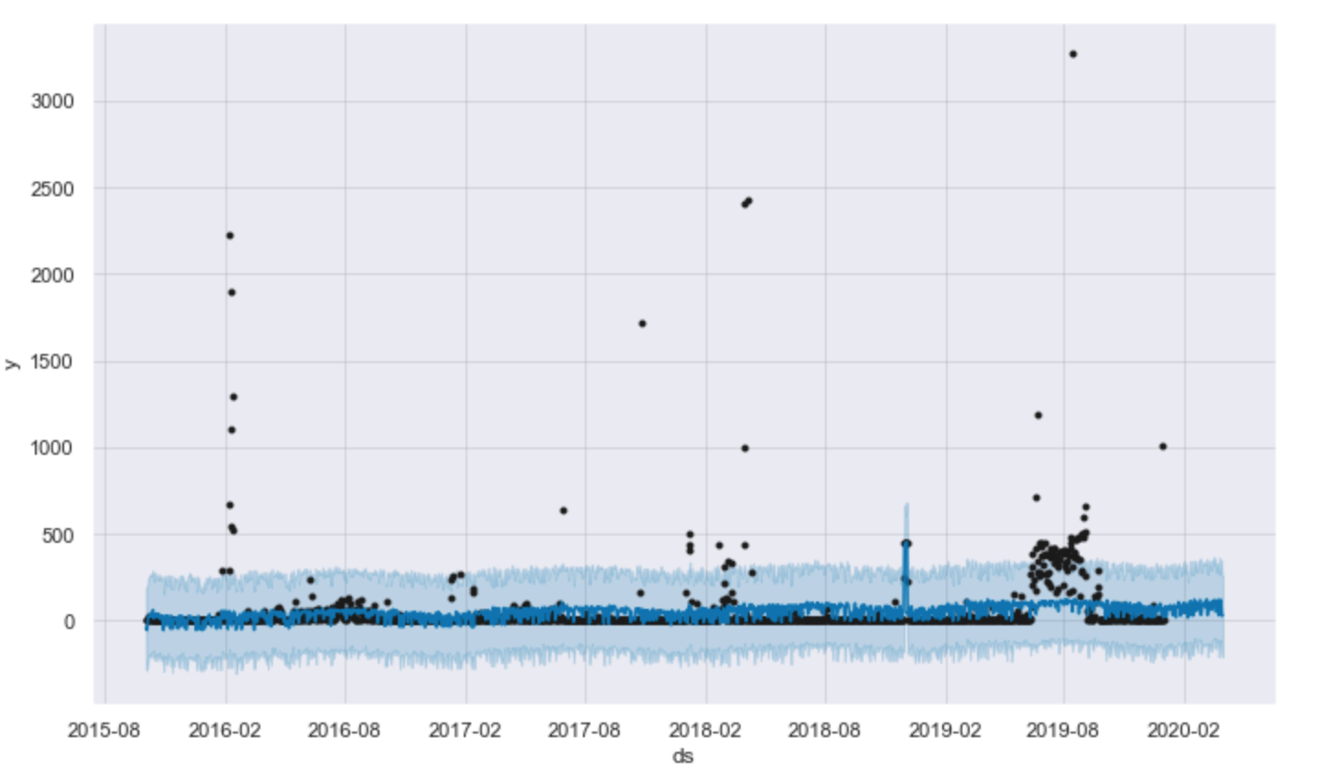
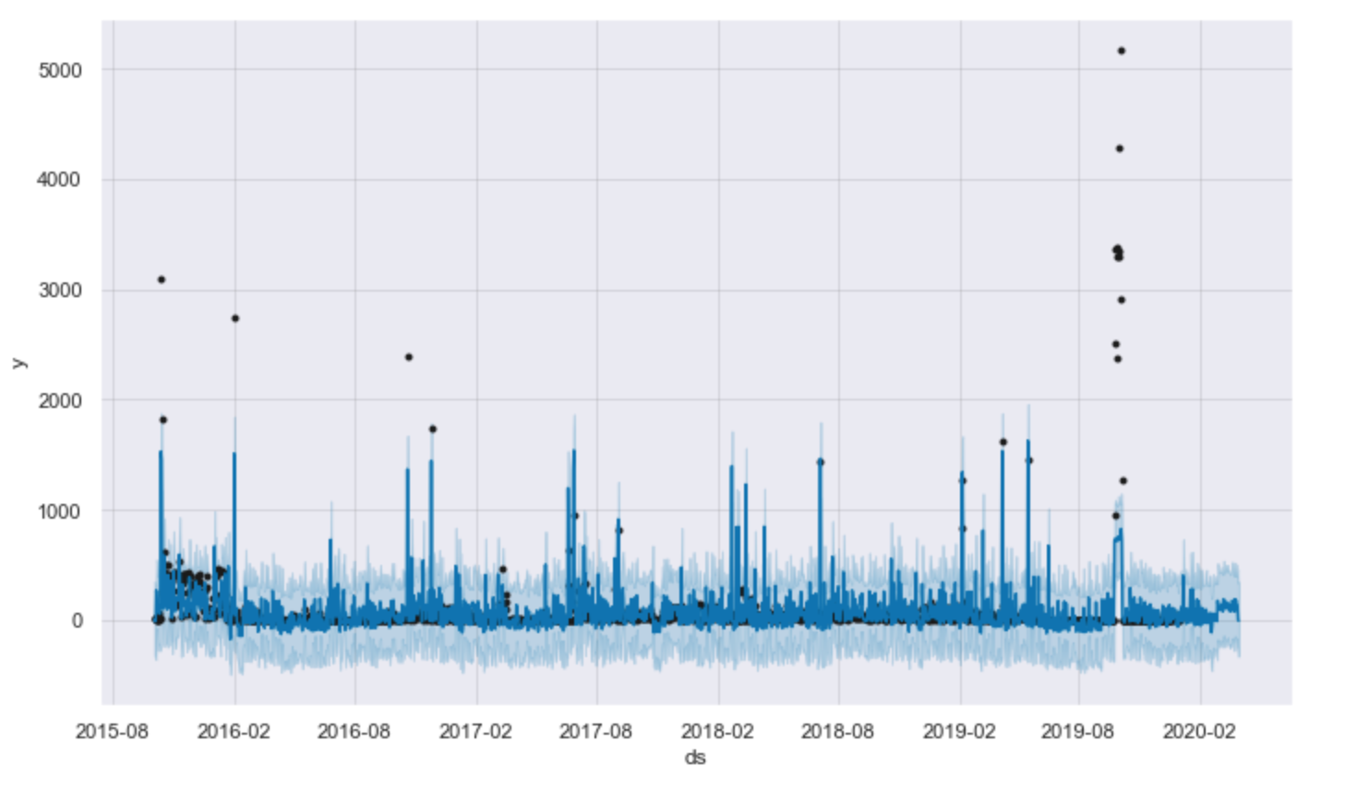
Each Inverter Forecast Separately

Slide 17
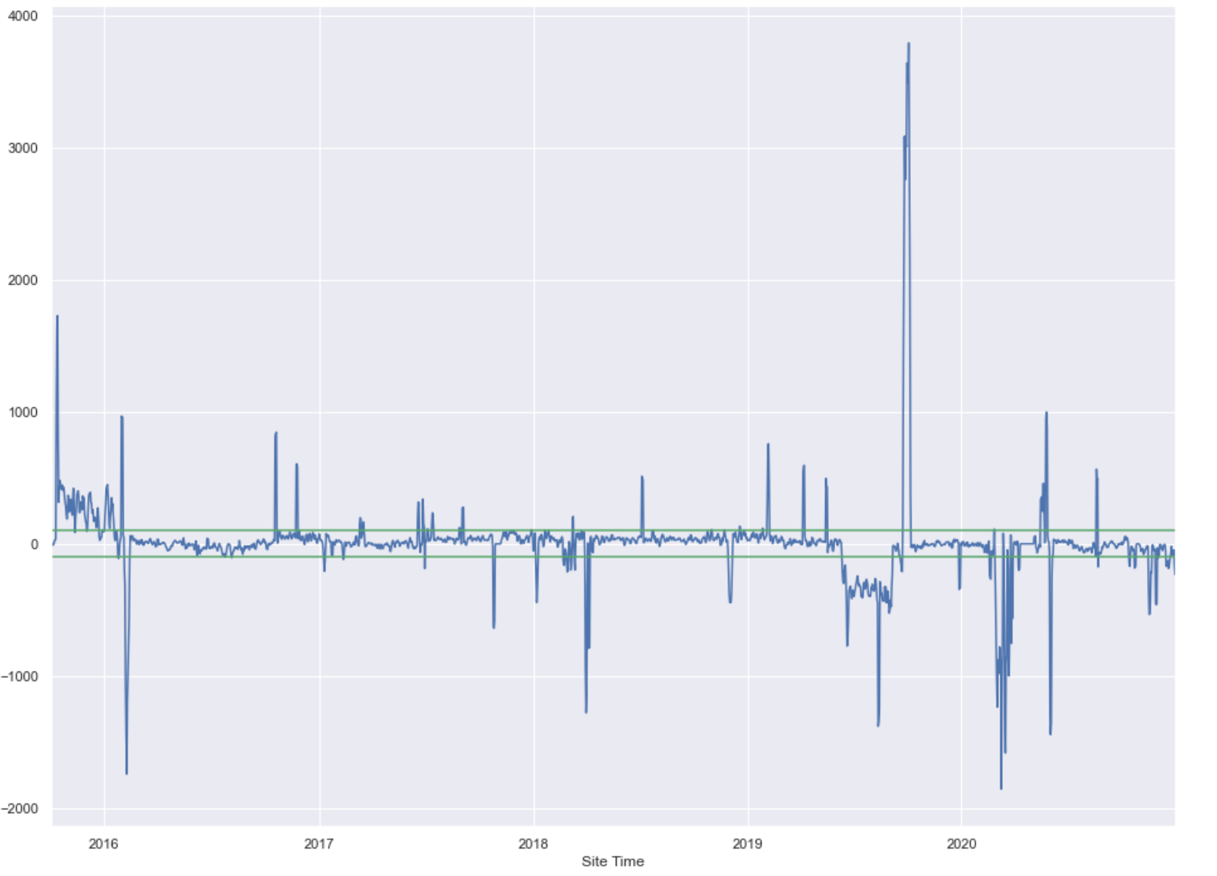
Classifier to Predict Poor Performance

Slide 18
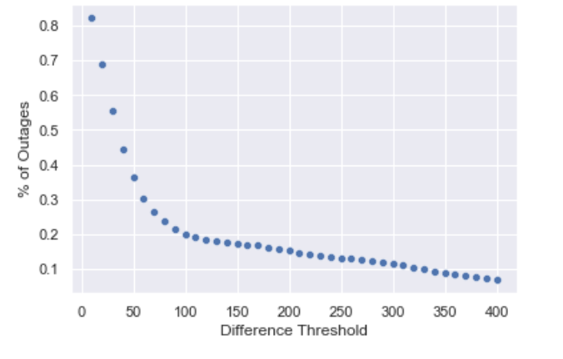
What is poor performance?

Slide 19
Feature Engineering
Inverter lag for each of the past seven days
Max ambient temperature for each of the past seven days
Max module temperature for each of the past seven days
Energy output for each of the past seven days
Max inverter lag for each of the past seven days
Month of the year

Slide 20
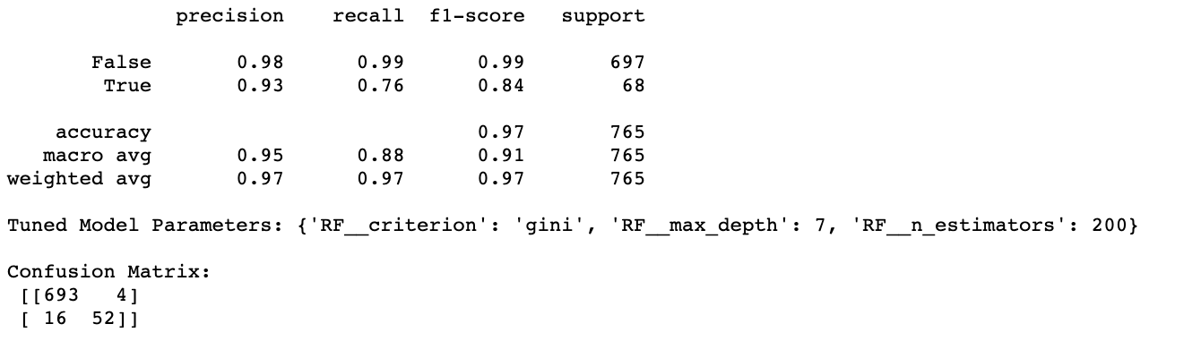
Random Forest
Trained on each inverter separately
Trained on both inverters together
Final Model

Slide 21
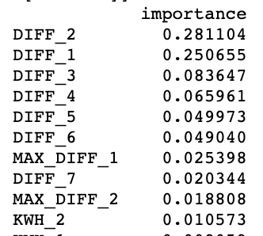
Important Features

Slide 22
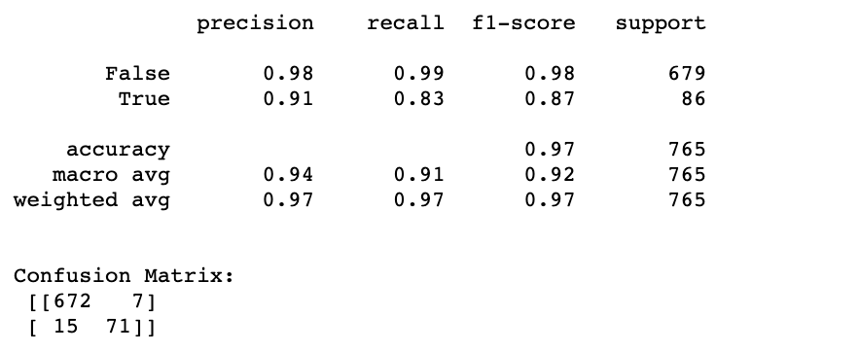
Support Vector Classifier

Slide 23
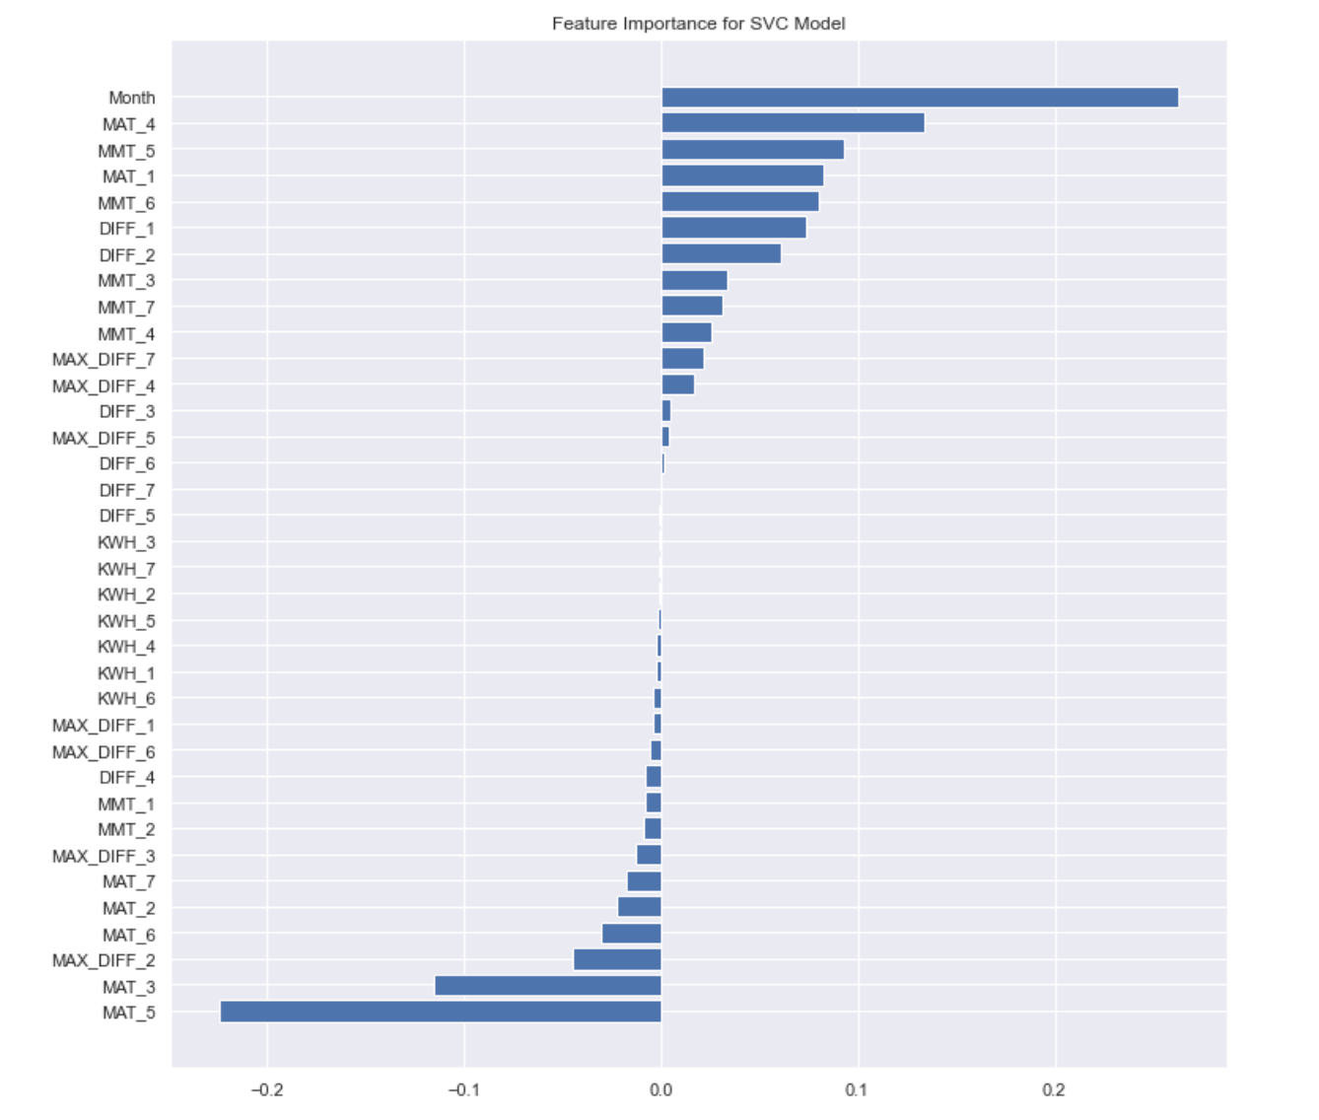
Important Features

Slide 24
Summary
Time series forecasting predicted degradation.
Forecasting of poor performance showed promise.
Classifiers both showed promise although SVC perhaps more interesting.

